Slide 1


Introduction to Computer Vision and Image Processing

Slide 2

What is OpenCV?
OpenCV (Open Source Computer Vision) is a library of programming functions mainly aimed at real-time computer vision. OpenCV supports the deep learning frameworks TensorFlow and PyTorch.
It has C++, Python, Java and MATLAB interfaces and supports Windows, Linux, Android and Mac OS.

Slide 3
How does OpenCV see things?
Images are made of elements called pixels. Typically, these pixels are organized in an ordered rectangular array.
The size of an image is determined by the dimensions of this array of pixels. Thus, the pixel array is a matrix of M columns x N rows. To refer to a specific pixel within the image matrix, we use its coordinate at x and y.
Every image will have width and height and therefore a image is a rectangle in the first quadrant of the coordinate systems. With the only difference being that Y axis is flipped.
(0,0)
M
N
(M, N)

Slide 4
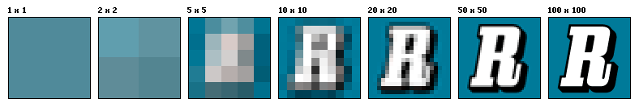
We see monitors and TVs having HD, FHD, FHD+, UHD, 8K etc. displays. What do you think is the difference between them?
The resolutions of the above go from 1280x720 to 7680x4320 increasing as we go to the right.
The difference between these is the number of pixels that can be displayed on the screen. The more number of pixels that are displayed, the sharper and more detailed the image is.

Slide 5
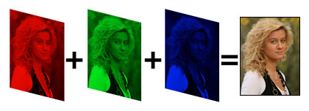
We usually work with 8-bit images. Here 8 bit refers to the depth of the image. An 8-bit intensity range has 256 possible values, 0 to 255.
RGB images use 8-bit intensity ranges for each color and B&W images have a single 8-bit intensity range. Since RGB images contain 3 x 8-bit intensities they are also referred to as 24-bit color images.
A pixel having RGB values (0,0,0) has a black colour, a lack of colour to be precise, while one with (255,255,255) has white colour.
The number of the colors of the image is known as its channels. For example, while a colored image has 3 channels (RGB), a grayscale image has only 1 channel.

Slide 6

Types of Images:
Grayscale Image:
The image here has only one colour chanel, with the pixel values ranging from 0-255. The depth is 8.
The image to the right is a grayscale image.

Slide 7
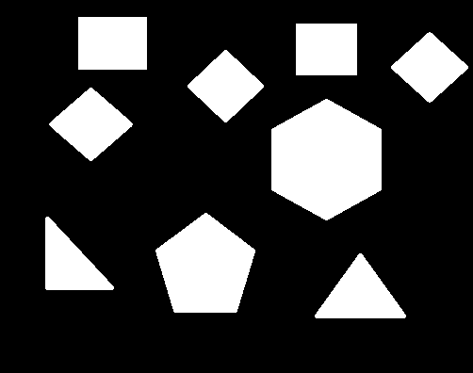
Binary image:
The pixel intensity values are either 0 or 1, where 0 corresponds to black and 1 corresponds to white. The depth and number of channels are 1.
We get binary images out of either HSV images or grayscale images. Thresholding, which will be discussed post a few slides plays a key role to obtain a binary image from a grayscale image.
Given below is an example of a binary image.

Slide 8
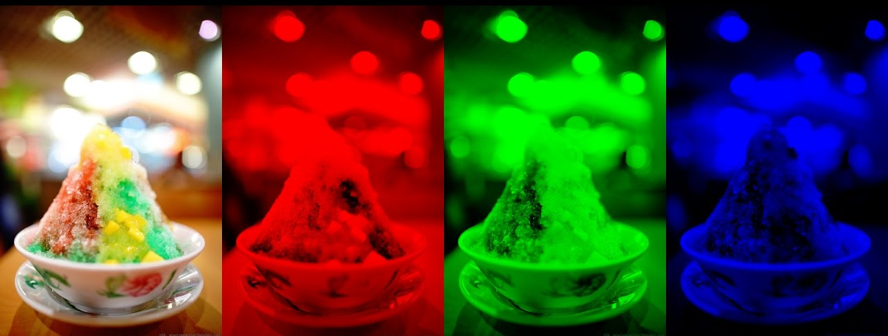
RGB image:
Pixel intensity values for each color varies from 0 to 255. Here the depth is 8 and the number of channels is 3, being red, green and blue.
Any color can be produced by altering color intensities of a pixel in these 3 channels.
Usually, graphical images are read in RGB format while OpenCV reads images in the BGR format.
A picture of an ice cream and its individual color channel intensities.

Slide 9
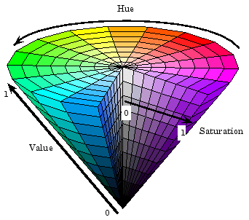
HSV image:
It is another format for colored images other than RGB. In this, a colored image is represented in terms of the Hue, Saturation and Value.

Slide 10
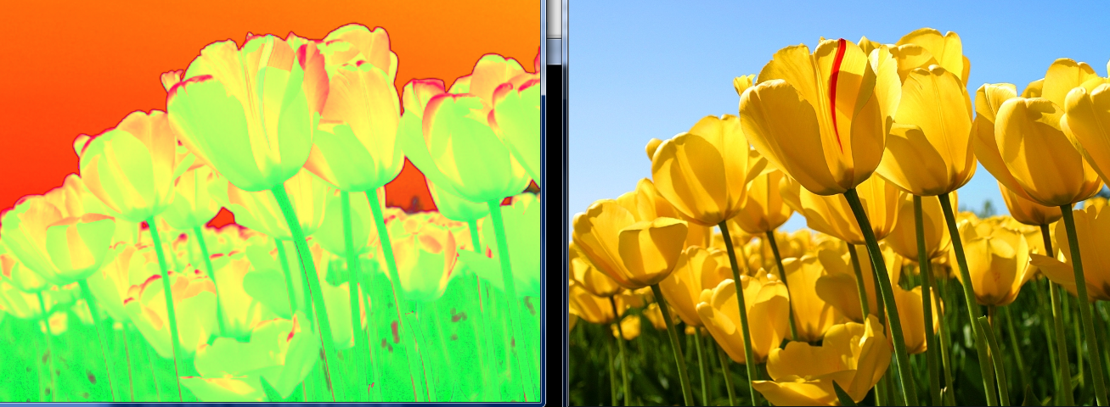
Why use a complicated HSV instead of a simple format like RGB?
HSV
RGB
HSV is more robust towards external lighting changes. This means that in cases of minor changes in external lighting (such as pale shadows,etc.) Hue values vary relatively lesser than RGB values. This is the reason HSV colorspace is preferred for color detection/thresholding over RGB/BGR.

Slide 11
Some Basic Functions in OpenCV
Always include “import cv2” In your code while using OpenCV. If OpenCV is not installed, use “pip install opencv-contrib-python” in command prompt.
cv2.imread() to read an image
Syntax: image = cv2.imread(‘destination of the file‘ , number)
Here, 1 as the number loads a color image while 0 loads image in grayscale mode.
cv2.imwrite() to save an image
Syntax: cv2.imwrite(‘location to be stored’, variable containing the image)
cv2.destroyAllWindows() is used to destroy the pop–up window. It usually follows after the waitKey() function so after the wait is over it destroys all the windows.
To create a named window:
Syntax: cv2.namedWindow(‘image’)
cv2.imshow(‘image’ , image)

Slide 12
Explanation: Suppose we want to attach a image with a particular image we use cv2.namedWindow() function. All though this is function is redundant in this case as cv2.imshow() does the job of creating a window as well as binding the image to it. The use of this function will become more clear when we use trackbars.
Conversion between color spaces:
Syntax: cv2.cvtColor(“input image”, “conversion mode”)
The color type of image is converted from one color space to another. The conversion mode of the image is the deciding factor of conversion. It states the initial and final color spaces. Some color conversion modes are as follows: cv2.COLOR_BGR2GHSV, cv2.COLOR_BGR2GRAY, cv2.COLOR_HSV2BGR

Slide 13
LET’S GET CODING
Our first program will be loading a simple image file from the computer:
import cv2
image = cv2.imread(C:\\Users\\Lenovo\\Desktop\\mypic.jpg’ , 0)
cv2.imshow(‘image’, image)
cv2.waitKey(0)
cv2.destroyAllWindows()

Slide 14
TASK 1
LOAD A COLOURED IMAGE AND CONVERT IT TO GRAYSCALE AND THEN SAVE IT

Slide 15
Our next program will be showing the live feed from computer’s web camera:
import cv2
cap = cv2.videoCapture(0)
while (True) :
_ , frame = cap.read()
cv2.imshow(‘show video’ , frame)
if cv2.waitKey(1) & 0xFF == ord(‘q’):
break
cap.release()
cv2.destroyAllWindows()
Here we insert 0 because we are using the inbuilt webcam instead if we want to use an external webcam we have to replace 0 by 1
To exit program at a specific key press can be any other key for keys like esc and spacebar we have their ASCII number
For esc program will be
if cv2.waitKey(1) & 0xFF == 27:
To release the camera

Slide 16
TASK 2
FROM LIVE A VIDEO FEED, CAPTURE AND SAVE A FRAME AT THE PRESS OF A KEY

Slide 17
How is an image created?
A blank binary can be create using functions np.ones(), np.zeros() which would create blank white or blank image respectively.
There are two arguments to be passed to the functions.
The first parameter is the dimensions of the array holding the values.
The second parameter specifies the datatype of the values we are going to enter.
Zeros specifies that all the 3 values stored has to be zeroes. So, we would get a blank black image on using np.zeros().
It's all exactly same for np.ones() except it would store 1 in all the places to
get a white image.

Slide 18
Basic Drawing Functions:
To draw a line on an image
Syntax: cv2.line(image, endpt1, endpt2 , color, thickness)
To draw a rectangle on an image
Syntax: cv2.rectangle(image, endpt1, endpt2 , color, thickness)
To draw a circle on an image
Syntax: cv2.circle(image, centre, radius, color, thickness)
Other functions to draw different shapes and text like ellipse, polygon and
puttext are also present.

Slide 19
What is Thresholding?
Thresholding is the simplest method of image segmentation. From a grayscale image, thresholding can be used to create binary images. Simply speaking, if a pixel intensity value is greater than a particular value (threshold) then it will be made black or white.
The cv2.threshold() function for this.
Syntax: ret, thresh_img = cv2.threshold(image, thresh_lim, set_value, method)
Arguments are image - the image on which the operation is to be performed; thresh_lim - it is the value of intensity above which the pixels’ intensity is to be altered, set_value - it is the value to which the intensity is altered, method - different types of thresholding
will be achieved by changing the method of threshold, they are:
cv.THRESH_BINARY, cv.THRESH_BINARY_INV, cv.THRESH_TRUNC, cv.THRESH_TOZERO, cv.THRESH_TOZERO_INV

Slide 20
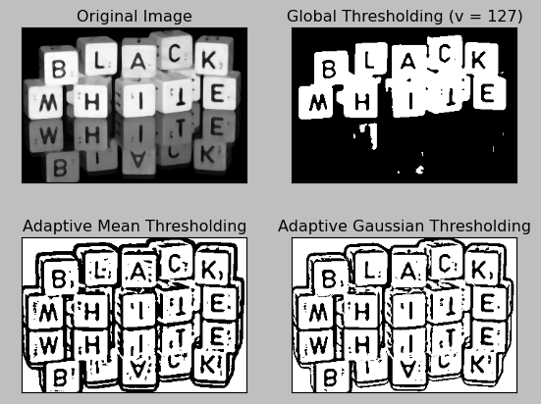
Among the types of thresholding, these two are the ones which are primarily used and serve all of the main purposes:
Simple Thresholding:
For images with uniform lighting conditions it gives almost the best thresholding.
Adaptive thresholding:
It is used when the lighting conditions are not uniform over the image.

Slide 21
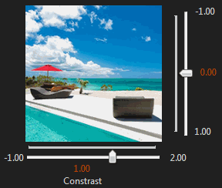
Trackbars
CREATE A TRACKBAR
cv2.createTrackbar(trackbar_name, ”img_window”, min_val, max_val, callback_fun)
GET VALUES FROM A TRACKBAR
cv2.getTrackbarpos(trackbar_name,”img_window”)

Slide 22
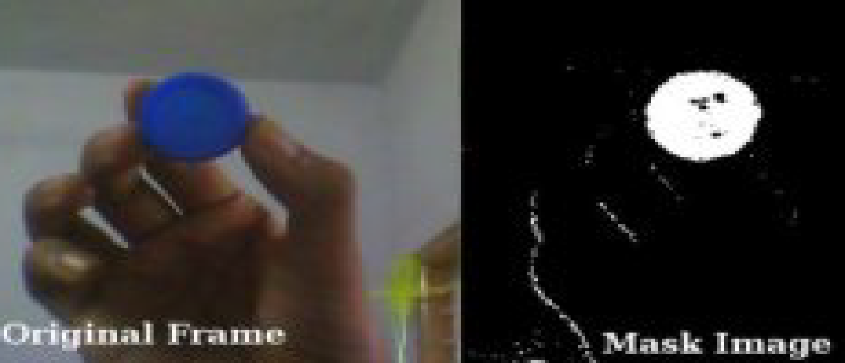
LETS DETECT A COLORED OBJECT FROM THE CAMERA
import numpy as np
import cv2
cap = cv2.videoCapture(0)
while (True) :
_ , frame = cap.read()
hsv = cv2.cvtColor(frame, cv2.COLOR_BGR2HSV)
lower_blue = np.array([110, 50, 50])
upper_blue = np.array([130, 255, 255])
mask = cv2.inRange(hsv, lower_blue, upper_blue)
final_result = cv2.bitwise_and( frame , frame , mask = mask )
cv2.imshow(‘video‘ , frame)
cv2.imshow(‘masked image‘ , mask)
cv2.imshow(‘resultant‘ , final_result)
if cv2.waitKey(1) & 0xFF == ord(‘q’):
break
cap.release()
cv2.destroyAllWindows()
If the hsv pixel value is within this range it will give one 1(white) otherwise it will give 0(black)
Hence we have a binary image

Slide 23
Bitwise Operations
When dealing with images, there might arise a need to extract certain parts of the image based on requirement. We make use of bitwise operators for this. They perform operations pixel wise and give the output as per the specification. We have three bitwise operators in OpenCV:
bitwise_AND
bitwise_OR
bitwise_NOT
Syntax for AND & OR operators:
new_img = bitwise_<operation>(img1, img2, mask)
Syntax for NOT operator: new_img = bitwise_NOT(img)

Slide 24
TASK 3
MAKE A MASK OF YOUR OWN FOR AN OBJECT OF YOUR LIKING FROM YOUR WEBCAM FEED

Slide 25
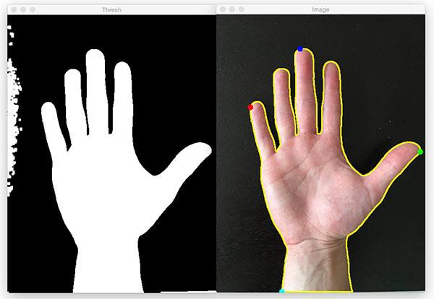
Contours:
A Contour is a curve joining all the continuous points (along the boundary), having same colour or intensity. Contours are a useful tool for shape analysis and object detection and recognition.

Slide 26
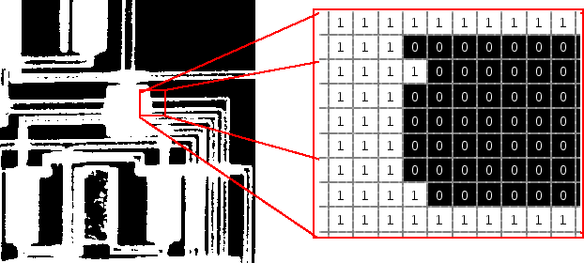

Slide 27
Finding Contours:
img, contours, Hierarchy = cv2.findcontours(img, hierarchy_mthd, contour_mthd)
There are three arguments in cv2.findContours() function, first one is source image, second is contour retrieval mode, third is contour approximation method. It gives back the image, contours and hierarchy. Contours is a Python list of all the contours in the image. Each individual contour is a Numpy array of (x,y) coordinates of boundary points of the object.
For better accuracy, binary images should be used. In OpenCV, object to be found should be white and background should be black.
Retrieval Methods:
RETR_LIST: Builds a hierarchy without any parent child relationships.
RETR_EXTERNAL: Returns only extreme outer contours.
RETR_CCOMP: Establishes two level hierarchy (Inner and Outer).
RETR_TREE: Returns all contours and establishes full family hierarchy.
Approximation Methods:
CHAIN_APPROX_NONE: Returns all the points along the contour
CHAIN_APPROX_SIMPLE: Compresses segments and leaves only their
end points.

Slide 28
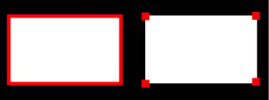
CHAIN_APPROX_NONE
CHAIN_APPROX_SIMPLE

Slide 29
DRAW CONTOURS
cv2.drawcontours(img, contours, n, (B,G,R), thickness)
Its first argument is the source image, second argument are the contours which should be passed as a Python list, third argument is index of contours (useful when drawing individual contour. To draw all contours, pass -1) followed by color, thickness.
The find and draw contours code pieces are used together for getting the desired output.
_, contours, _ = cv2.findContours(img, cv2.RETR_TREE, cv2.CHAIN_APPROX_SIMPLE)
img = cv2.drawContours(img, contours, -1, (0, 255, 0), 3)
Preferably, a thresholded image is passed for better accuracy.

Slide 30
Contour Features:
Area:
cnt = contours[0]
area = cv2.contourArea(cnt)
Returns Area of the 1st contour cnt if you want 2nd contour replace 0 by 1 and so on.
Perimeter:
perimeter = cv2.arcLength(cnt , True)
Returns perimeter. Second argument specify whether shape is a closed contour (if passed True), or just a curve.
Minimum enclosing circle :
We find the circumcircle (of min. area) of an object using the function cv2.minEnclosingCircle().
(x , y) , radius = cv2.minEnclosingCircle(cnt)
center = (int(x) , int(y))
radius = int(radius)
img = cv2.circle(img, center, radius, (0,255,0), 2)
There are many other contour functions like for finding minimum bounding
rectangle, for finding the centroid etc.

Slide 31
Task 4
TAKE AN IMAGE OF SHAPES ON A PAPER, DRAW THE SHAPES ON A BLANK CANVAS USING OPENCV

Slide 32
Blurring an Image:
Why do we blur an image?
It is useful for removing noise. It actually removes high frequency content (eg: noise, edges) from the image. So edges are blurred a little bit in this operation (there are also blurring techniques which don't blur the edges).
So, what is a kernel?
In image processing, a kernel is just a small matrix. It is also known as a convolution matrix.
It is used for blurring, sharpening, embossing, edge detection, and more. This is accomplished by doing a convolution between a kernel and an image.
Convolution is simply an element-wise multiplication of two matrices followed by
a sum.

Slide 33
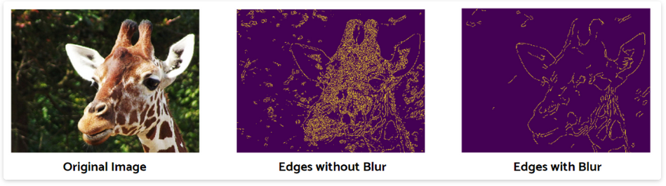
A slight amount of blur removes excess noise as see above.

Slide 34
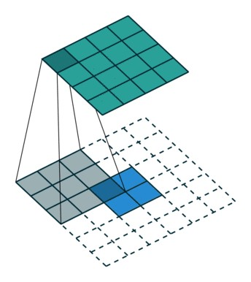
Image Blurring:
Image blurring is achieved by convolving the image with a low-pass filter kernel. It is extremely useful for removing noise. There are different types of blurring in OpenCV. We will be discussing only about the Gaussian Blur.
Gaussian Blur :
We use cv2.GaussianBlur() function for this. A gaussian kernel is used for this. Gaussian filtering is highly effective in removing Gaussian noise from the image. This acts as a weighted mean for an individual pixel intensity with the neighbouring pixel intensities. The higher the kernel size, the higher the blur.
Syntax:
blur = cv2.GaussianBlur(img, (5,5), 0)

Slide 35
Geometric Transformations:
OpenCV provides two transformation functions. cv.warpAffine() and cv.warpPerspective(), with which you can have a wide range of transformations.
cv.warpAffine() takes a 2x3 transformation matrix, while cv.warpPerspective() takes a 3x3 transformation matrix as input.

Slide 36
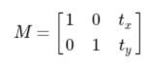
Translation:
Translation is the shifting of object's location.
If the shift in (x,y) direction is known, let it be (t_{x}, t_{y}), the transformation matrix M can be created as follows:
You can take make it into a Numpy array of type np.float32 and pass it into cv.warpAffine() function.
M = np.float32([[1, 0, t_{x}], [0, 1, t_{y}]])
img = cv.warpAffine(img,M,(cols,rows))

Slide 37
Affine Transformation:
In affine transformation, all parallel lines in the original image will still be parallel in the output image. To find the transformation matrix, we need three points from input image and their corresponding locations in output image. Then cv.getAffineTransform() will create a 2x3 matrix which is to be passed to cv.warpAffine().
Syntax:
matrix = cv.getAffineTransform(input, output)
Example:
img = cv.imread('drawing.png')
rows, cols, ch = img.shape
pts1 = np.float32([[50, 50], [200, 50], [50, 200]])
pts2 = np.float32([[10, 100], [200, 50], [100, 250]])
M = cv.getAffineTransform(pts1, pts2)
dst = cv.warpAffine(img, M, (cols, rows))

Slide 38
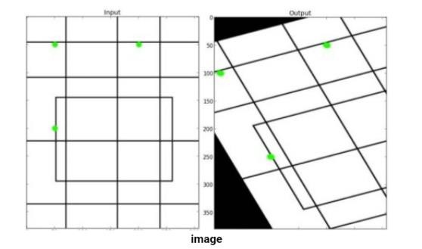

Slide 39
Perspective Transformation:
For perspective transformation, a 3x3 transformation matrix is needed. Straight lines will remain straight even after the transformation. To find this transformation matrix, 4 points on the input image and corresponding points on the output image are needed. Among these 4 points, no 3 should be collinear. Then, transformation matrix can be found by the function cv.getPerspectiveTransform(). Then, apply cv.warpPerspective() with this 3x3 transformation matrix.
Example:
img = cv2.imread("rmi_pic.jpeg")
rows, cols, channels = img.shape
pts1 = np.float32([[30, 170], [322, 25], [225, 448], [489, 178]]) #get initial points
pts2 = np.float32([[0, 0], [300, 0], [0, 300], [300, 300]]) #get final points
M = cv2.getPerspectiveTransform(pts1, pts2) # gives us a 3x3 transformation matrix
perspective_transform = cv2.warpPerspective(img, M, (300, 300))

Slide 40
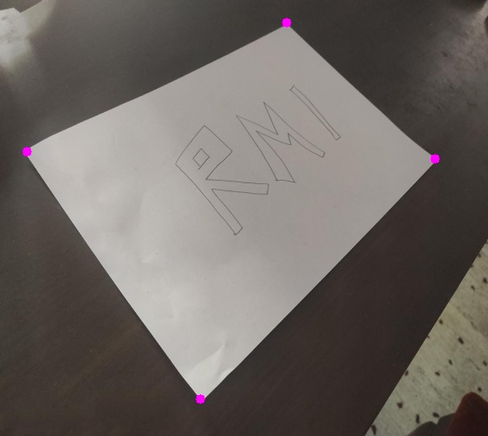
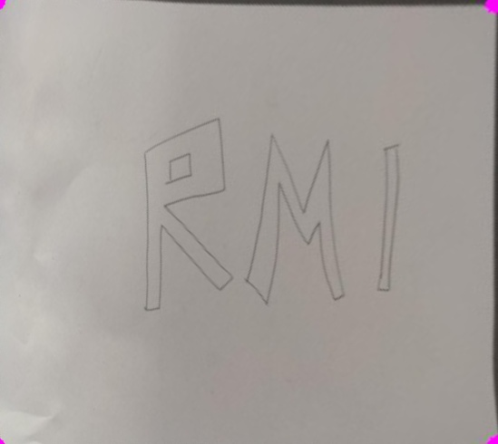

Slide 41
Morphological Transforms:
Morphological Transforms are simple operations which are based on the shape of an image. They are generally performed to reduce noise. These transforms need two inputs, the source image and the kernel. The kernel acts as a filtering element that is slid over the image to produce a filtered image.
Types of Morphological Transformation are:
Erosion
Dilation
Opening
Closing

Slide 42

Erosion:
Syntax:
kernel = np.ones((5, 5), np.uint8)
erosion = cv2.erode(img, kernel, iterations = 1)
The kernel slides through the image (as in convolution). A pixel (at the centre of the kernel) in the original image will be made 1 only if all the pixels under the kernel is 1, else it is eroded (made 0).
So, the thickness or size of the foreground object decreases or simply white region decreases in the image. The higher the number of iterations, the thinner the image gets.

Slide 43

Dilation:
Syntax:
kernel = np.ones((5, 5), np.uint8)
dilation = cv2.dilate(img , kernel, iterations = 1)
Dilation is just the opposite of erosion. Here, a pixel (at the center of the kernel) is given ‘1’ if at least one pixel under the kernel is ‘1’. So, it increases the white region in the image or size of foreground object increases. Normally, for applications like noise removal, erosion is followed by dilation.

Slide 44

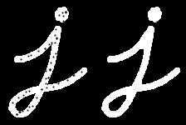
Opening and Closing:
Opening and closing are simply erosion followed by dilation; and dilation followed by erosion respectively.
Syntax:
Opening: cv2.morphologyEx(img, cv2.MORPH_OPEN, kernel)
Closing: cv2.morphologyEx(img, cv2.MORPH_CLOSE, kernel)
Opening
Closing

Slide 45
Thank You

